Slide 1
Concept of a ‘module’
A module is a basic building block in Verilog and can specify a system of any complexity.
The module definition is the same for a system of any complexity.
Provides functionality through its port interface.
It can be an element or a collection of lower-level design (macro or leaf cells or primitive cells) blocks.

Slide 2
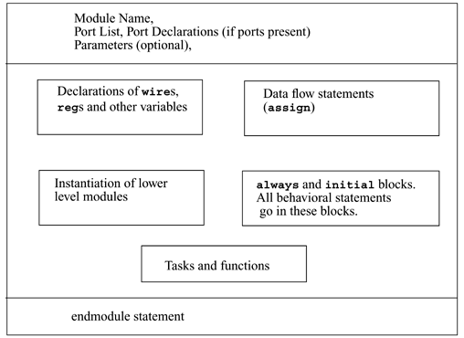
Components of a Verilog Module

Slide 3
How to declare a module ?
A module in Verilog is declared using the keyword module and a corresponding keyword endmodule must appear at the end of the module.
Each module must have a module name, which acts as an identifier.
A module can have an optional port list which describes the input, output & inout terminals of the module.

Slide 4
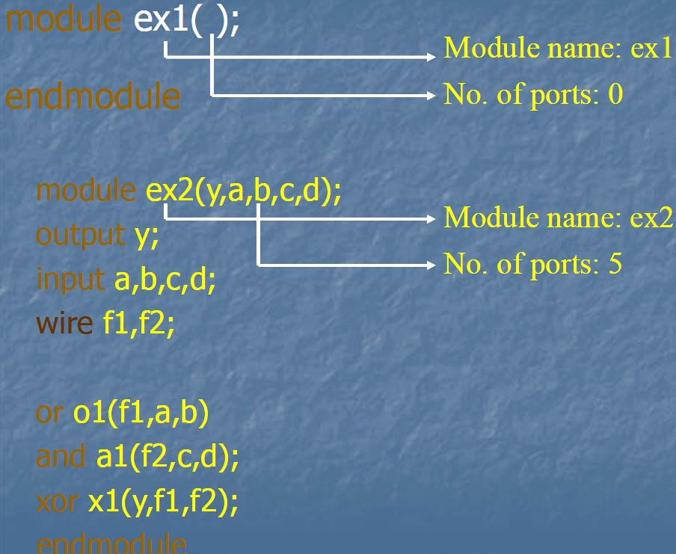
Module declaration - Examples
A module communicates with the other modules or the external environment through its ports. So the functionality of any module is reflected through its ports by hiding the internals of the module, which describes the functionality for that module.

Slide 5
Nesting of modules
In Verilog nesting of modules is not permitted i.e., one module definition cannot contain another module definition within the module and endmodule statements.
module counter(q, clk, reset);
output [3:0]q;
input clk, reset;
module T_FF(q, clock, reset) // Illegal
.
endmodule
endmodule

Slide 6
Module instances
A module provides a template from which one can create actual objects.
Each object has its own name, variables, parameters and I/O interface.
The process of creating objects from a module template is called instantiation, and the objects are called instances.
Primitives and modules can be instantiated.
Notes:
In verilog nesting of modules is illegal. That is one module definition cannot contain another module definition within the module and endmodule statements. But one module definition can contain one or more instances of other modules. The instantiated modules reflect their functionality through their ports in the module which had instantiated them.
Every module instance should have its instance name. But for primitive instantiation the instance name is optional. Even it is recommended that the primitive instantiation should have the instance name, so that multiple instances of the same primitive can be identified by their instance name.

Slide 7


Module instantiation
ex1 and ex2 as objects
in top module
Module ex1
Top module
module templates
Module ex1
Module
ex2
Module
ex2
Primitive 1
Primitive 2
Notes:
In the above example, the module 1 and module 2 functionality had to described at first, with the help of module definitions. there after if we want to make use of them in other module then they have to be instantiated in the corresponding module(here it is main module.
But writing the module definitions of module 1 and module 2 inside the main module definition is not allowed in verilog.

Slide 8
Ports
All ports in the list of ports must be declared in the
module. Ports can be declared as follows:
Verilog Keyword | Type of Port
input | input port
output | output port
inout | bidirectional

Slide 9
Port Declarations
module fulladd4(sum, c_out, a, b, c_in);
//Begin port declarations section
output [3:0] sum;
output c_cout;
input [3:0] a, b;
input c_in; //End port declarations section ...
<module internals> ...
endmodule

Slide 10
Data types
Net Data type
Registers Data type

Slide 11
Data Type
A variable belongs to one of two data types
Net:
Must be continuously driven
Used to model connection between continuous assignments and Instantiations.
Register:
Retains the last value assigned to it.
Often used to represent storage element.

Slide 12
Net Data Type
Nets represent connections / physical wires between hardware elements.
Nets will not store / hold any value.
Different net types supported for synthesis:
wire , wor, wand, tri , supply0, supply1
wire and tri are equivalent ; when there are multiple drivers, driving them, the output of the drivers are shorted together.
wor / wand inserts an OR/AND gate at the connection.
supply0 / supply1 model power supply connections.
Default Size : 1-bit / scalar
Default Value : z
Notes:
The nets should have the values continuously driven on them, otherwise by default they go to high impedance state(z). Unless and until a net is driven by some driver it takes the value of z.

Slide 13
Wire declaration examples
wire a; // signal ‘a’ declared as wire
wire out; // signal ‘out’ declared as wire
Ex: assign out = a | b; or o1(out, a, b);
wire a, b; // signals ‘a’ & ‘b’ declared as wires
wire d = 1’b0; /*net ‘b’ is fixed to logic value ‘0’ at declaration*/

Slide 14
Registers
In Verilog registers represent data storage elements.
Used to model hardware memory elements / registers.
Registers can hold / store a value.
Declared by the keyword reg , integer
Default Size : 1-bit / scalar
Default Value : x
Notes:
Unless a value is written in to register it holds a ‘x’ value by default in it.
Once a value is inside the register, the value doesn’t change unless another value is written in to it(i.e. the reg data types have the capability to store the values).
The other register data types are integer, real, time register

Slide 15
Vectors
Nets or register data types can be declared as vectors (more no. of bits).
If bit width is not specified then the default value is 1-bit (scalar).
wire a; // default scalar net value
wire [7:0] bus; // 8-bit bus
wire [31:0] busA, busB, busC; //32- bit bus
reg clock; // scalar register(default)
reg [0:40] virtual_addr; //virtual address 41 bits

Slide 16
Addressing Vectors
wire [15:0]busA;
busA[9]; // bit # 9 or 10th bit of vector busA from LSB
wire [0:15]busB;
busB[9]; // bit # 9 or 7th bit of vector busB from LSB
reg [31:0]cnt_out;
cnt_out[14:7]; // group of 8 bits of a vector register
cnt_out[7:14]; // is illegal addressing

Slide 17
Reference
1. Samir Palnitkar,”Verilog HDL: A Guide to Digital Design and Synthesis” Prentice Hall, Second Edition,2003

